Slide 1
D&D INVENTORY/SHOP INTERFACE
By Zak Meyers

Slide 2
THE IDEA
- To create an interface that players of D&D can use to keep track of their character’s inventory and items in the game.
- To add in functionality for a shop allowing users to purchase items.

Slide 3
USER STORIES
- As an adventurer, I would like the functionality to view known items within the world, so that I can keep track of items that I may want to obtain.
As an adventurer, I would like to be able to add and update items to the known items list as new items are discovered throughout my travels.
As an adventurer, I would like to be able to add items to my inventory when I obtain them, and delete them once I have no further use for them.
As an adventurer, I would like to be able to purchase items from a shop and have the items transferred to my inventory, so that I can obtain items that I have not previously discovered.

Slide 4
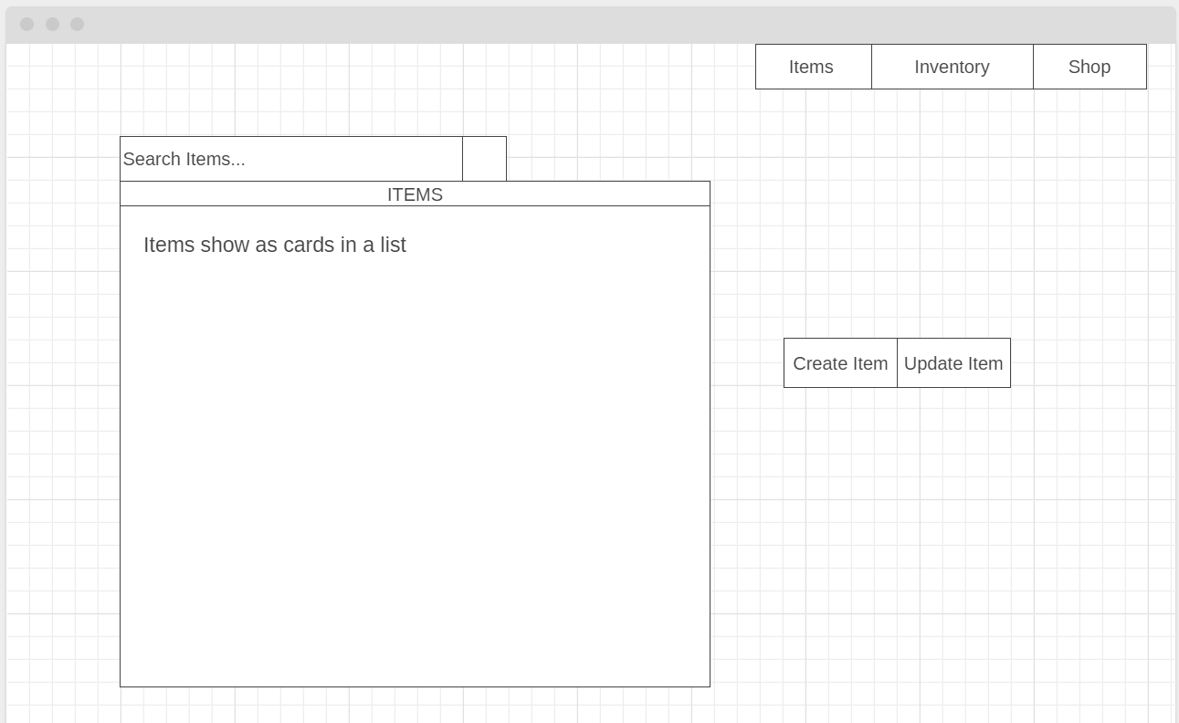
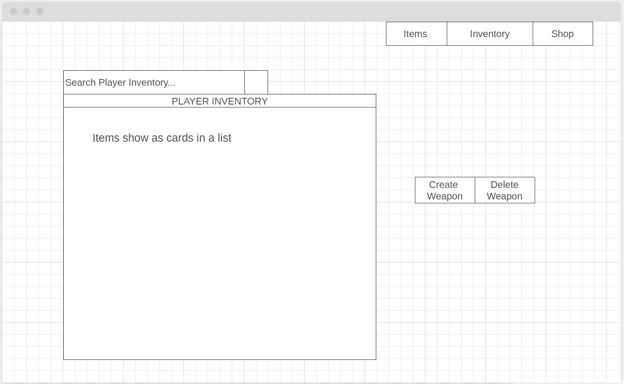
WIREFRAMES: ITEMS & INVENTORY

Slide 5
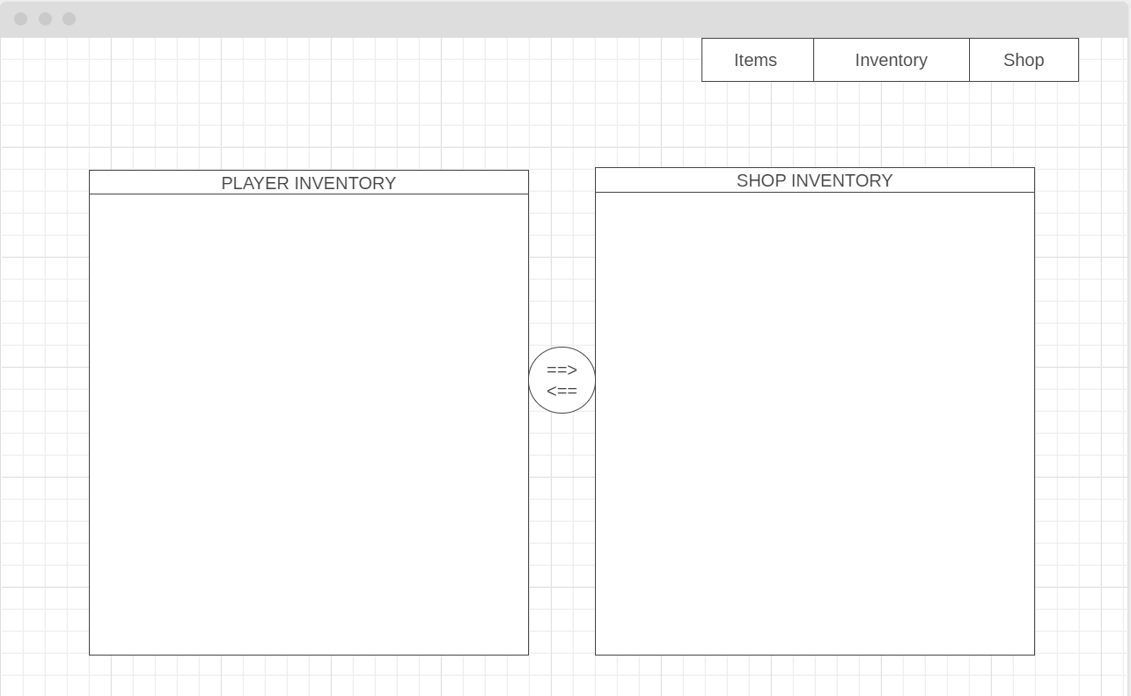
WIREFRAMES: SHOP INTERFACE

Slide 6
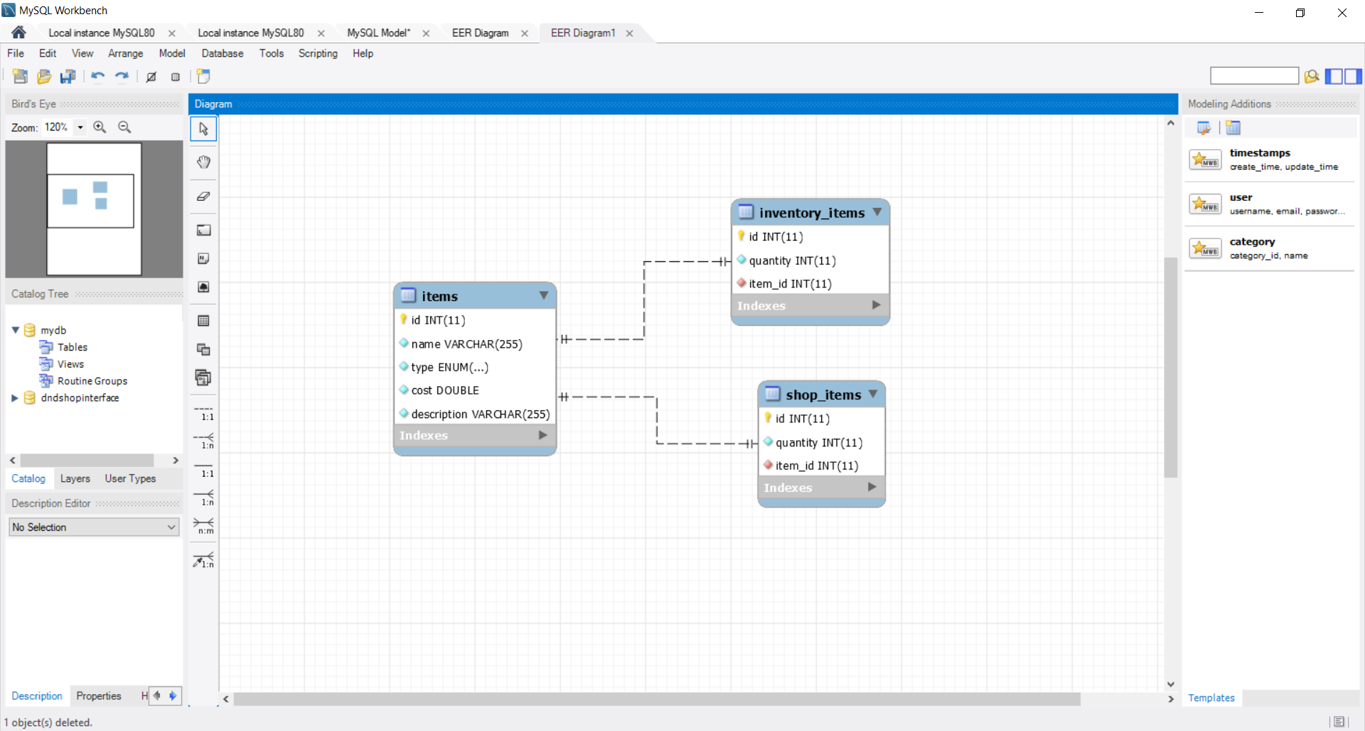
ENTITY RELATIONSHIP DIAGRAM

Slide 7
REVIEW
What Went Well
The CRUD functionality through the back-end server side was implemented and tested in Postman relatively quickly and without issue.
HTML and CSS implemented successfully on all HTML pages created.
CRUD functionality linked through the front-end via javascript on the items page and functionality on the shop and inventory pages.
Complications
The implementation of the CRUD functionality through the front-end took longer than anticipated, especially for the “add item to inventory” function on the Inventory and Shop pages.
User input checks were pushed back to sprint 2 due to the delay in the add item to inventory functions.

Slide 8
WHAT’S NEXT?
User input checks to ensure that users cannot input anything that would cause the code to break.
Alternative to the user input for which item to add/update/drop/buy: Implement dropdown menus including all item options. Ensure that user cannot try to manipulate items that don’t exist.
Login/Register functionality so users can store their own inventories.
Get the “add to inventory” buttons working that time did not permit for.
Add functionality that will change the quantity of items in the shop when they are bought.

Slide 9
WHAT WOULD CHANGE?
Start off by implementing the dropdown menus first instead of the user text input at current.
Add user input validation at the same time the user input functionality is written in the front-end.
Delays occurred when time was spent focusing on certain aspects of the CRUD implementation through the front end. With the new familiarity of the CRUD functions using javascript, these CRUD functions would be much faster to create.

Slide 10
SUMMARY
Estimated time spent working on project since start of Monday 11/11:
~23 hours outside of work hours.
~20 hours during the work week.
Total: ~43 hours
THANKS FOR LISTENING, ANY QUESTIONS?

